Slide 1
Types of Statements
DDL (Data Definition Language)
used to create and modify the structure of database objects in database.
create, alter, drop, truncate….
DCL (Data Control Language)
used to create roles, permissions, and control access to databases
grant, revoke…
DML (Data Manipulation Language)
used to retrieve, store, modify, delete, insert and update data in database.
select, insert, update, delete… (CRUD/CURD)

Slide 2
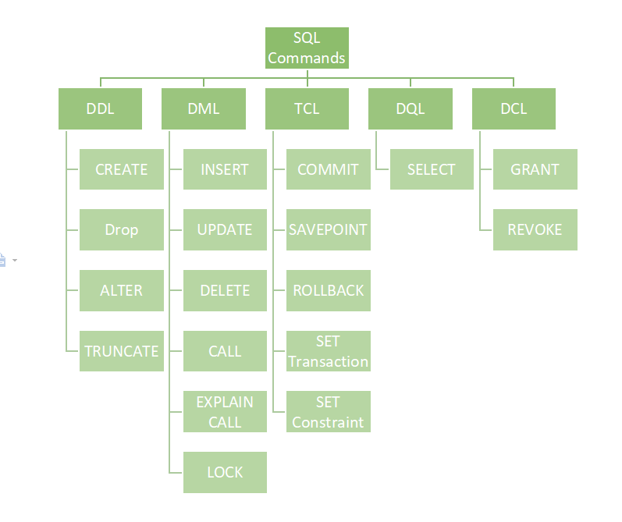
Types of Statements

Slide 3
Statements & Operators
Select, from, join on, order by
* in select statement -> should avoid(future schema change…)
where
filtering when no aggregation is involved
group by
used along with aggregation Functions -> use group by to disambiguate other columns
having
filtering after a group by
Inner join and outer join
Performance: Move Where to On / Specify multiple On conditions to improve performance
Distinct
Top -> useful when sampling data

Slide 4
Statements & Operators
offset
Specifies the number of rows to skip. The value needs to be greater than or equal to zero.
fetch
Specifies the number of rows to return after the OFFSET clause. The value needs to be greater than or equal to one.
Alias

Slide 5
Count
Count(col) vs Count (*) vs Count(1) vs Count(expr)
Count(col) only counts non-null values in the col
count(*) counts all the tuples in a group
count(<expr>) counts all the tuples in group for which <expr> evaluates to something not null
in SQL Server, count(1) and count(*) has no real performance difference according to a sql server dev from MS

Slide 6
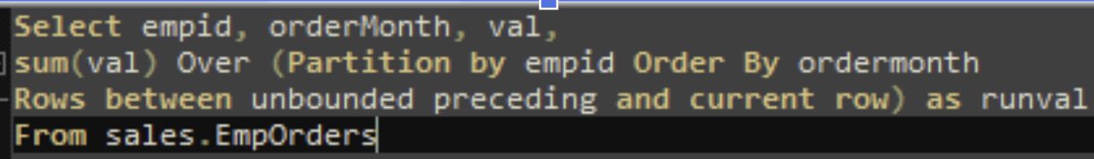
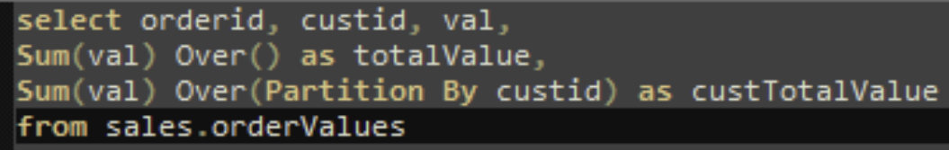
Window Functions
Window Functions
aggregation: sum, max, min, avg,count
ranking: rank, dense_rank, row_number, ntile
value: lag, lead,first_value, last_value

Slide 7
Window Functions
Why use window functions?
input rows will be retained, unlike in a group by
aggregated values will be added as a new column
The full syntax of window functions is actually very complex, with many optional parameters/keywords, check for details here

Slide 8
Statements & Operators
Like
https://docs.microsoft.com/en-us/sql/t-sql/language-elements/like-transact-sql?view=sql-server-ver15
Wildcard character | Description | Example
% | Any string of zero or more characters. | WHERE title LIKE '%computer%' finds all book titles with the word 'computer' anywhere in the book title.
_ (underscore) | Any single character. | WHERE au_fname LIKE '_ean' finds all four-letter first names that end with ean (Dean, Sean, and so on).
[ ] | Any single character within the specified range ([a-z]) or set ([abcdef]). | WHERE au_lname LIKE '[C-P]arsen' finds author last names ending with arsen and starting with any single character between C and P, for example Carsen, Larsen, Karsen, and so on. In range searches, the characters included in the range may vary depending on the sorting rules of the collation.
[^] | Any single character not within the specified range ([^a-f]) or set ([^abcdef]). | WHERE au_lname LIKE 'de[^l]%' all author last names starting with de and where the following letter isn't l.

Slide 9
Statements & Operators
Date
https://docs.microsoft.com/en-us/sql/t-sql/functions/date-and-time-data-types-and-functions-transact-sql?view=sql-server-ver15
DATEDIFF (datepart, startdate, enddate)
the difference between the two provided dates using datepart as the unit.
DATEADD (datepart, number, date)
adds a number(signed int) to a datepart of an input date, and returns a modified date/time value
datepart
https://docs.microsoft.com/en-us/sql/t-sql/functions/datepart-transact-sql?view=sql-server-ver16

Slide 10
SubQueries
Subqueries can be used for additional data source or a filter (correlated subquery)
If used in FROM (including Join) clause, need alias name
Scalar subquery (only 1 value returned, use =)
Multivalued subquery (multiple values returned, use IN)

Slide 11
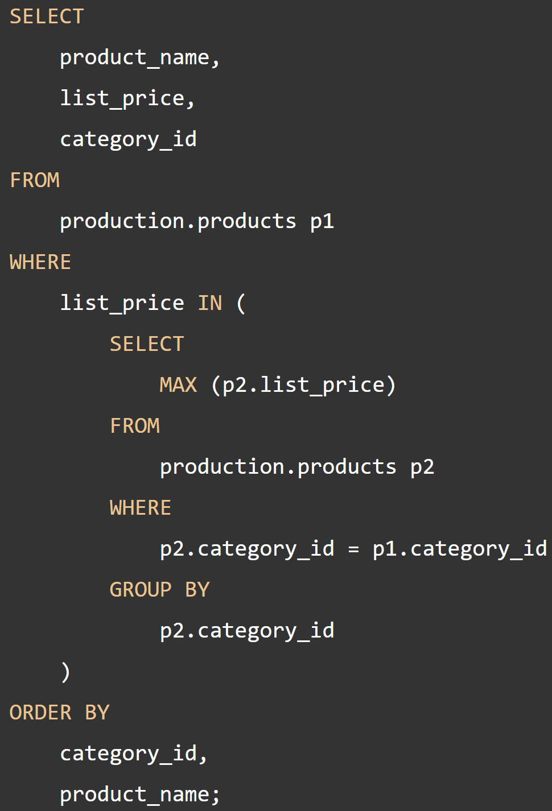
SubQueries
Correlated Subquery
a subquery that uses the values of the outer query
subquery will need to run for every row processed in the outer query
avoid due to bad performance

Slide 12
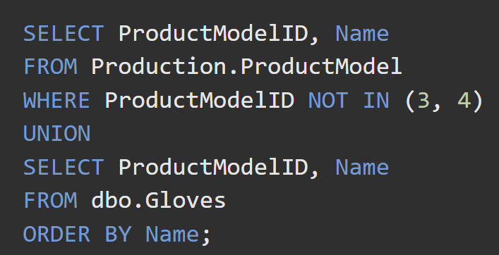
SET Operators
UNION
Specifies that multiple result sets are to be combined and returned as a single result set.
UNION ALL
Incorporates all rows into the results, including duplicates. If not specified, duplicate rows are removed.

Slide 13
SET Operators
Intersect
returns distinct rows that are output by both the left and right input queries operator.
Except
returns distinct rows from the left input query that aren't output by the right input query.
To combine the result sets of two queries that use EXCEPT or INTERSECT
The number and the order of the columns must be the same in all queries.
The data types must be compatible.

Slide 14
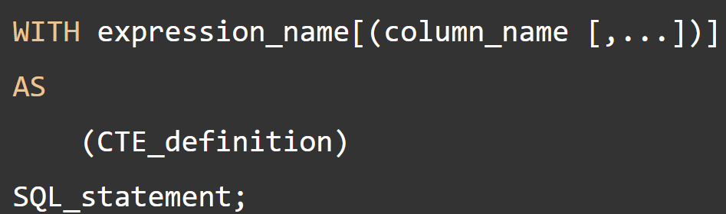
Common Table Expression
Use WITH keyword, optional Column Declaration on Top
multiple CTEs can be created using a single WITH, separate the expression_name with the previous CTE_definition using a comma.
CTEs go out of scope when outer query finishes

Slide 15
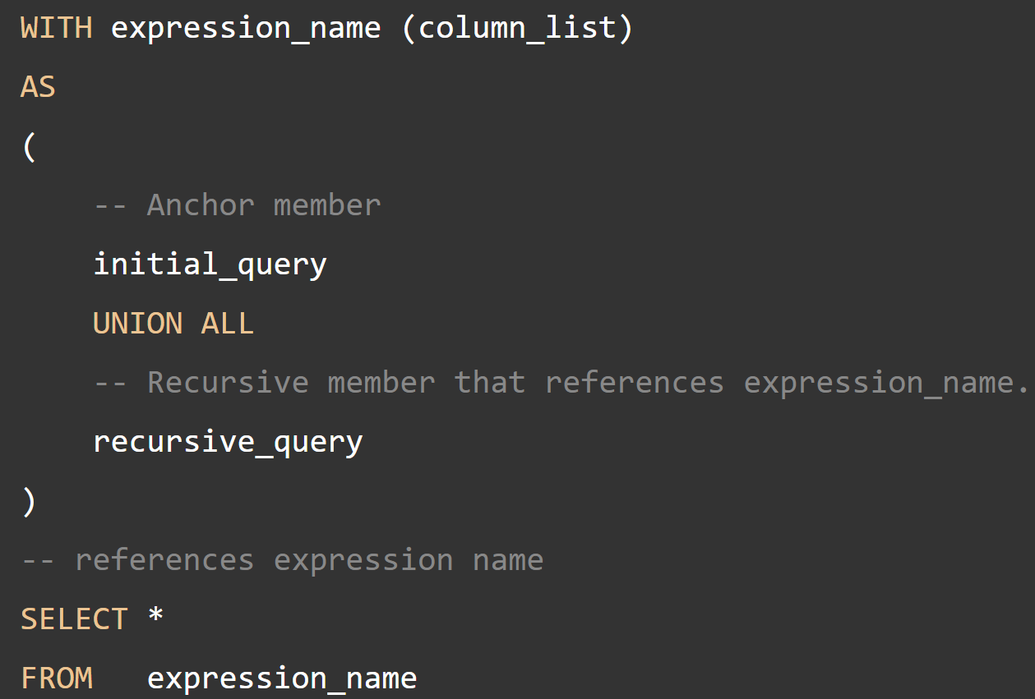
Common Table Expression
Recursive CTE
CTEs can be used to perform recursion in SQL
a recursive CTE is a CTE that references itself
often used to show hierarchies in the data
https://www.sqlservertutorial.net/sql-server-basics/sql-server-recursive-cte/

Slide 16
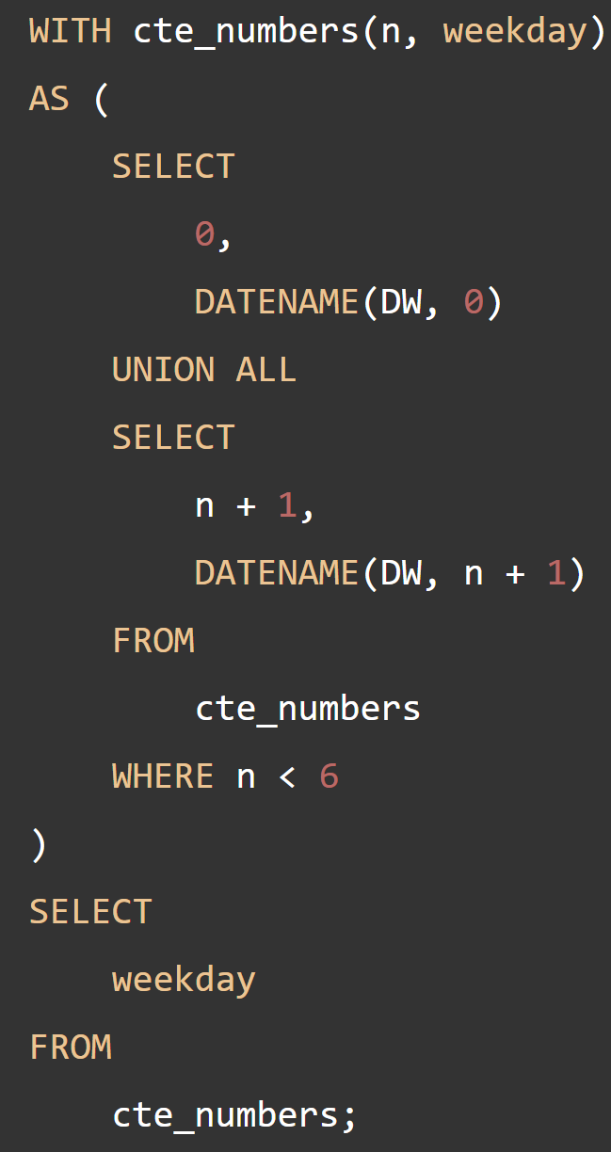
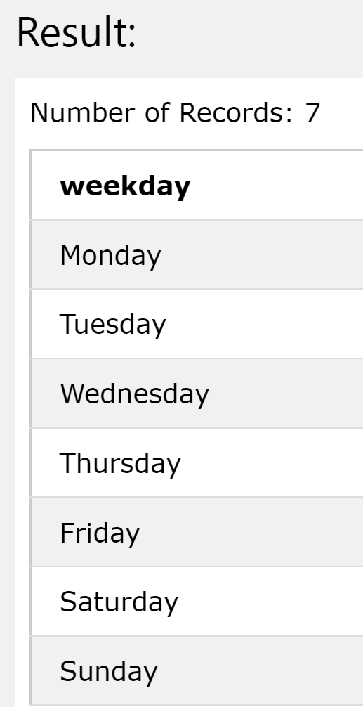
Common Table Expression

Slide 17
View
a virtual table whose contents are defined by a query
View is one of the most commonly used object by Data Engineers
Acts as a filter on the underlying tables referenced in the view
Flexible Permission, we can grant user access to a view without granting them access to underlying tables

Slide 18
View
Basic user defined views
Does not store any data.
Indexed/Materialized Views
view definition computed and data stored like a table, with unique clustered index
Not suitable when underlying tables are frequently changed
Partitioned View
Read data from a set of member tables across one or more servers.

Slide 19
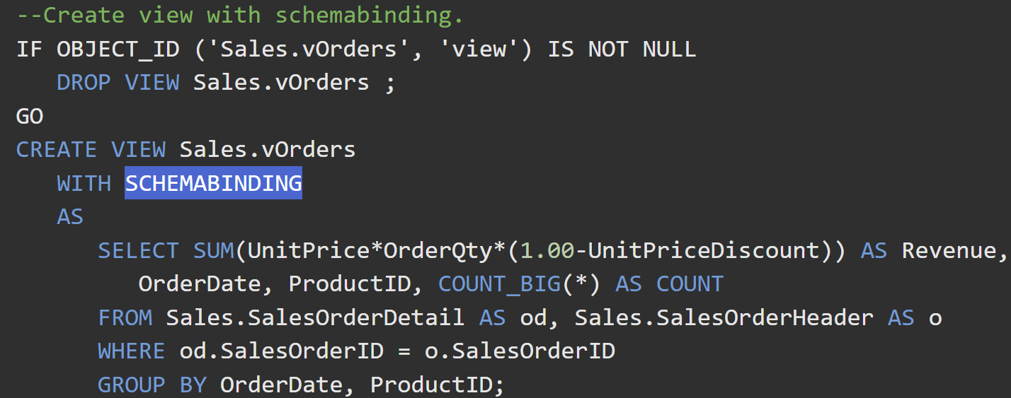
Basic User-defined View
Creating a view
Requires CREATE VIEW permission in the database and ALTER permission on the schema
SCHEMABINDING will prevent schema modifications of the underlying table that will affect the view

Slide 20
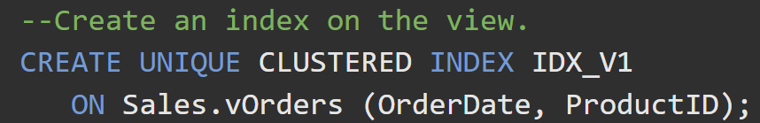
Indexed View
Creating an indexed view
First create a unique clustered index on the view
Then you can create other non-clustered indexes
For additional requirements (must be the view owner to create an index, view definition must be deterministic…) refer to:
https://docs.microsoft.com/en-us/sql/relational-databases/views/create-indexed-views?view=sql-server-ver15

Slide 21
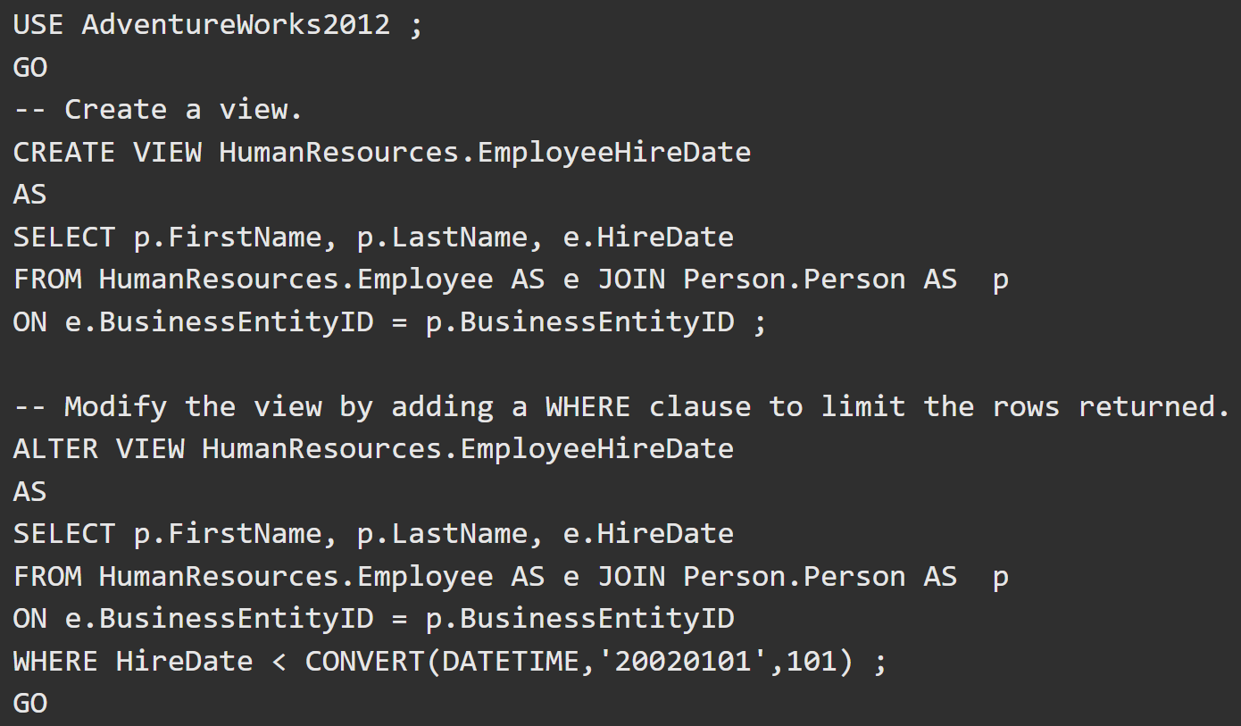
Modifying View Definition
Modifying a view
ALTER VIEW will drop all indexes on the view

Slide 22
Modifying Data through Views
When the stars are aligned, it is possible to update data through a view, syntax is identical to update data in a table.
all modifications must only reference columns from a single base table
derived/aggregated columns can’t be modified
The columns being modified are not affected by GROUP BY, HAVING, or DISTINCT clauses.
TOP is not used anywhere in the select_statement of the view together with the WITH CHECK OPTION clause.

